Slide 1
An extension to, and the implementation of an intelligent charging station (software/hardware) for electric vehicles (based on embedded Linux and Ethernet) following ISO 15118 AC/DC charging with CAN bus
Batch 12: german project team
JIZtom francis kavalakkatt 311113106022
Nivas gokul manimurugesan 311113106040

Slide 2
objective
To design and develop a Human Machine interface(HMI) for an electric car charging station running on ISO 15118 protocol or older CP/PP (SAEJ1772) protocol.
It should also :
Detect and lock in power cable
Receive inputs
Display real time charging process

Slide 3
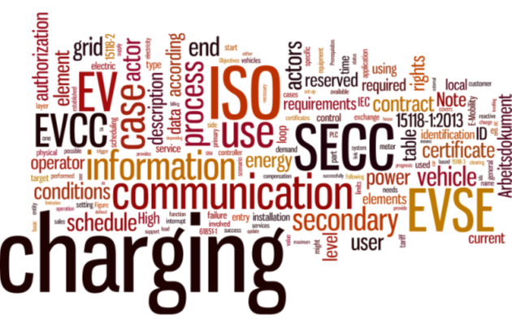
Literature survey

Slide 4
Sl. NO | Paper/Reference Details | Outcome | Inference
1. | Vehicle-to-Grid AC charging station : An approach for smart charging development D. Wellisch et. Al Deggendorf Institute of Technology – technology campus Freyung. | The basic guide line on how to approach the charging with vehicle to grid communication | Required details and model construction of the ISO 15118 smart charging model
2 | Electric Vehicle Charging Infrastructure – Security Considerations and Approaches Rainer Falk et al Siemens AG Munich, Germany. | The security issues faced with the ISO 15118 actors | The security requirement to be followed to improve deadlines and failure in the system

Slide 5
Sl. NO | Paper/ Reference Details | Outcome | Inference
3 | Introduction to ISO 15118 Vehicle-to-Grid Communication Interface Begleitforschung „Schaufenster Elektromobilität“ | A basic introduction on the ISO15118 and its relationship with the Smart Grid Network | The overview of the ISO 15118 model and its performance aspect
4 | ISO-IEC-15118-2 Conformance Test Descriptions PowerUp | Specifications on the proposed plans for ISO 15118 | The technical specifications
5 | Development of a fault tolerant CAN bus interface based on the Raspberry Pi single board Computer Timothy DominikWidmer University of Zurich | Introduction and execution of CAN bus on Raspberry pi | Socket programming on Raspberry pi

Slide 6

Block diagrams

Slide 7
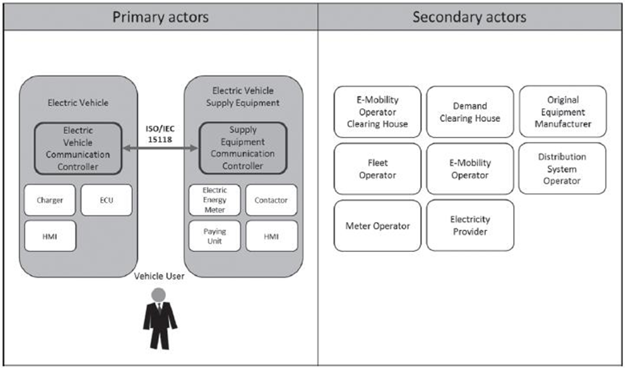
Iso/IEC 15118 actors

Slide 8
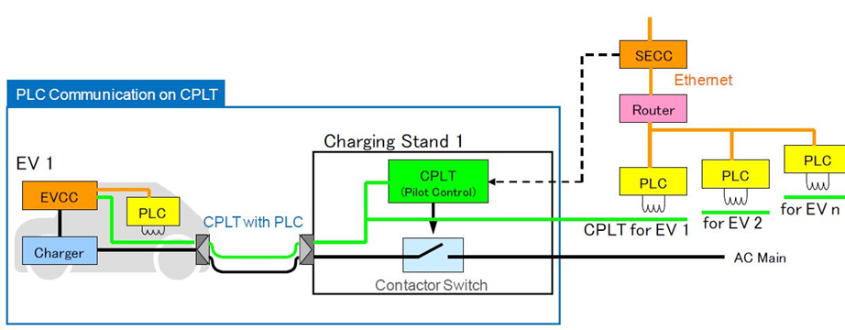
Plc communication on control pilot line (cplt)

Slide 9
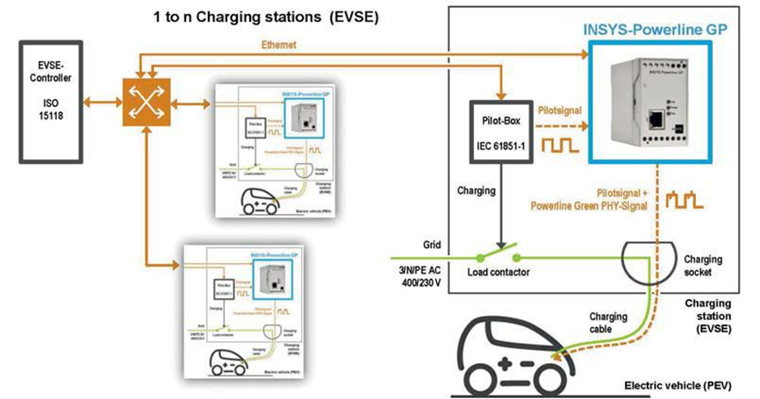
The insys power line gp as a commercial solution

Slide 10

Protocols being used
A brief abstract on the protocols being used in the project.

Slide 11
Abstract - ISO/IEC 15118-1:2013
ISO 15118 specifies the communication between Electric Vehicles (EV), including Battery Electric Vehicles and Plug-In Hybrid Electric Vehicles, and the Electric Vehicle Supply Equipment (EVSE). As the communication parts of this generic equipment are the Electric Vehicle Communication Controller (EVCC) and the Supply Equipment Communication Controller (SECC), ISO 15118 describes the communication between these components. Although ISO 15118 is oriented to the charging of electric road vehicles, it is open for other vehicles as well.
ISO 15118-1:2013 specifies terms and definitions, general requirements and use cases as the basis for the other parts of ISO 15118. It provides a general overview and a common understanding of aspects influencing the charge process, payment and load levelling.
ISO 15118 does not specify the vehicle internal communication between battery and charging equipment and the communication of the SECC to other actors and equipment (beside some dedicated message elements related to the charging). All connections beyond the SECC, and the method of message exchanging are considered to be out of the scope as specific use cases.

Slide 12
Abstract – IEC 61851-1: 2010 :
IEC 61851-1:2010 applies to on-board and off-board equipment for charging electric road vehicles at standard a.c. supply voltages (as per IEC 60038) up to 1 000 V and at d.c. voltages up to 1 500 V, and for providing electrical power for any additional services on the vehicle if required when connected to the supply network. It includes characteristics and operating conditions of the supply device and the connection to the vehicle; operators and third party electrical safety, and the characteristics to be complied with by the vehicle with respect to the a.c./d.c. EVSE, only when the EV is earthed.

Slide 13
CAN Bus Protocol: ISO 11898
A Controller Area Network (CAN bus) is a vehicle busstandard designed to allow microcontrollers and devices to communicate with each other in applications without a host computer.
CAN is a multi-master serial bus standard for connecting Electronic Control Units [ECUs] also known as nodes. Two or more nodes are required on the CAN network to communicate. The complexity of the node can range from a simple I/O device up to an embedded computer with a CAN interface and sophisticated software. The node may also be a gateway allowing a standard computer to communicate over a USB or Ethernet port to the devices on a CAN network.

Slide 14
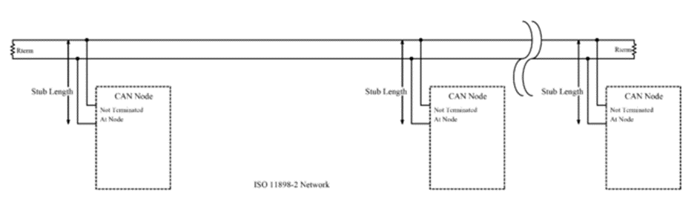
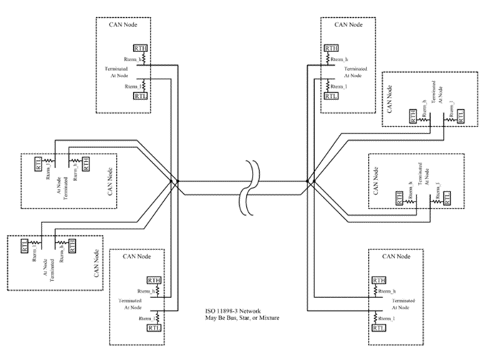
ISO 11898-2 NETWORK
ISO 11898-3 NETWORK

Slide 15
Advantages/Applications of the proposed system
Allows for larger pool of electric cars and reduce the no. of fossil fuel based cars.
Allows for better control of the spikes at peak hours which may cause blackouts or overloads.
Safer and faster charging with comfortable interface.

